Slide 1
Guardomic – your Bot Mitigation Engine
Dissemination level: Public
Disclosing Party: Koma Nord, Idego, PSNC
Recipient Party: Project consortium
Contact: adam.majewski@komanord.pl
Website: www.guardomic.eu
Notes:
Together with Idego company and Poznan Supercomputing and Networking Center, we work as Pilot4 group within EOSC-hub project, and we created a system called Guardomic. The name came from the words: guard on the micro level.

Slide 2
Guardomic - Your Bot Defense
what is Guardomic?
Crypto Web Mining
Digital Ad Fraud
Web Form Spam
Content Scraping
Incorrect Analytics
Unauthorized Access
Notes:
Guardomic is a system to protect online services from botnet attacks. On this slide you can see some exmples of threats for web servers.
The most common we can think of is unathorized access (for example based on brute force attack).
Other example is running unwanted code on web server. During last years quite popular was code for crypto web mining (like bitcoin mining)
Content scraping. If you have an online store or website presenting in details price offer of your products and services including some marketing promotions, for sure you would like to protect them from automatic content scanning by your competitors. Using Guardomic you we can do it.
Another problem are incorrect analytics. Traffic generated by bots makes that analytics from web server are inaccurate.
Last but not least – digital ad fraud. This is very big problem for companies using online advertising – they loose billion of dollars. (Based on information from Association of National Advertisers and White Ops in 2016 a bot-based waste was estimated at the level of $7.2 BILLION dollars).
Niechciany kod – np. kopalnie kryptowalut
Oszustwa reklamowe – np. opłaty za kliknięcia generowane przez boty
SPAM z formularzy, który zaśmieca nasz serwis WWW i wymaga zwiększonej pracy administracyjnej
Skanowanie treści – nie chcemy aby konkurencja w łatwy i automatyczny sposób pozyskiwała szczegółowe informacje o naszej ofercie, promocjach, działaniach marketingowych
Nieprawdziwa analityka – spora część ruchu generowanego na naszej stronie jest ruchem generowyanym przez boty, co zakłóca analityki, które prowadzimy aby np. lepiej dostosowywać zawartość naszego serwisu WWW
Nieautoryzowany dostęp – np. ataki typu brute force

Slide 3
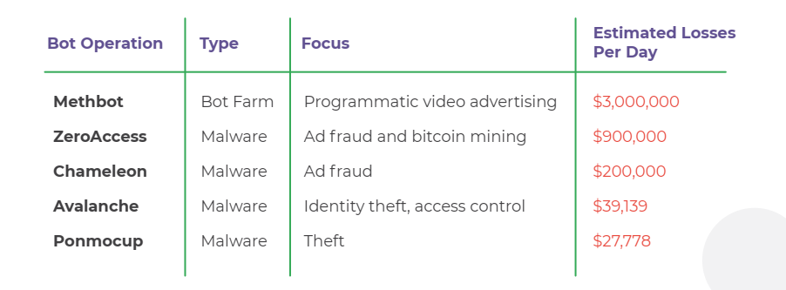
Bad Bots = Billion Dollar Losses
Notes:
Let’s take a short look at the table. It shows some examples of losses generated by bots.
Only one botnet attack named Methbot (2016) was able to generate a loss in video advertising on a level of $3 million a day.
How it could be done? By fake audience, fake users, fake traffic, fake clicks and advertisers has to pay for exposure and clicks that never took place.
But how are ad fraudsters able to steal this amount of money considering the sophistication of online advertising technology (AdTech)? Fake audience, fake users, fake traffic, fake clicks and fake installs – it all boils down to the same goal: advertisers are made to pay for exposure and clicks that never took place.
https://clearcode.cc/blog/rtb-online-advertising-fraud/

Slide 4
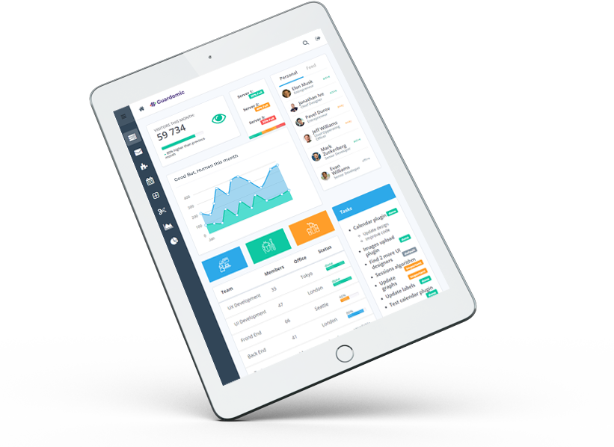
Guardomic – Your Bot Mitigation Engine
simple solution
automatic protection
without affecting user performance
improving the performance of the web server
scalability
analytics based on self-learning
Notes:
Guardomi c is very simple solution to use. It is enough to add a domain name to be protected and the owner of this domain has to redirect traffic to this domain by changing DNS settings.
In such simple way we can have automatic protecion without affecting user performance.
By reducing the amount of traffic which reaches to the protected web server it improves the performance of this web server.
System is designed to be able to lineary scale-up when there will be more traffic to analyse.
Przykładowe funkcje ochrony:
- Blokowanie po adresie IP lub całych podsieci lub z poszczególnych krajów
Zliczanie żądań z pojedynczych adresów IP
Wykrywanie i blokowanie rozwiązań typu koparki kryptowalut
Wykrywanie i blokowanie ruchu z sieci TOR
Blokowanie ruchu z list RBL (Real-time Blackhole list)
- blokowanie ataków brute-force
Wykrywanie ruchu z sieci proxy (bazując na liście Proxy Server List)
- Blokowanie określonych metod żądań (np. Blocking HEAD requests, allowing only GET and POST on certain pages)
Blokowanie ruchu próbującego zlokalizować wrażliwe adresy URL, które dla danej domeny nie istnieją (np. /admin, /wpadmin, /phpmyadmin itp.)
Blokowanie prób pobrania pełnej treści np. z wykorzystaniem PhantomJS
Wykrywanie ruchów z centrów hostingowych – większe prawdopodobieństwo ruchu botowego lub typu adware
Spowalnianie lub ograniczanie ruchu, który został zaklasyfikowany jako podejrzany
Blokowanie ruchu, który przekracza określoną liczbę żądań na minutę lub sesję
Blokowanie ruchu z innych aplikacji niż przeglądarki
Raporty prezentujące szczegóły ruchu związanego z naszym serwisem WWW, dostępne w łatwy i przejrzysty sposób, zarówno w formie tabelarycznej umożliwiającej szczegółowe przeglądanie jak i w formie zbiorczych wykresów.

Slide 5
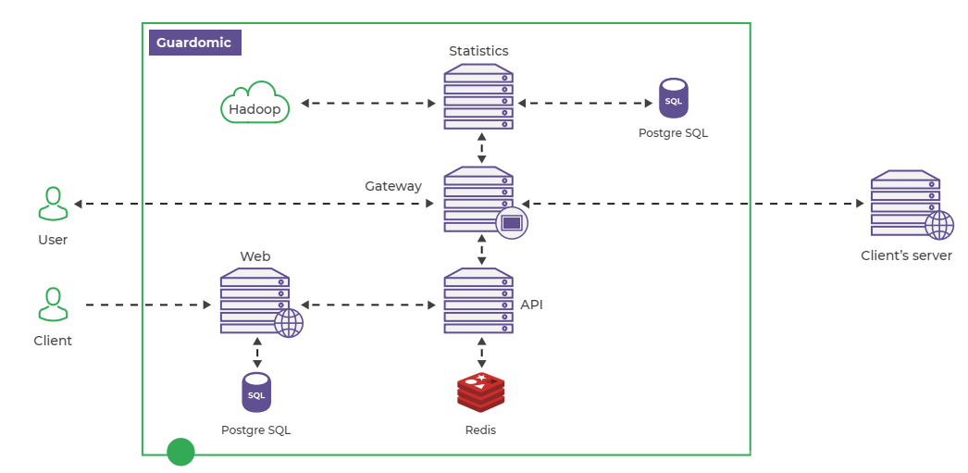
A PICTURE OF OUR SOLUTION:
Notes:
The system works like a proxy between web server and the user connecting from Internet. When user connects to domain (some web site) protected by Guardomic,
all requests to that domain will flow through our Gateway, which will block or allow this requests to the target web server.
Guardomic API is the main module with engine to correctly determine whether a certain request should be filtered or not.
Statistics module gather all information about traffic, and taken actions. Allow to implement self-learning functionality.
Guardomic Web is the main dashboard – a place where you log in to manage protected domains, change your settings and watch the statistics. You can use monitoring mode, pre-defined templates or manually switch on/off some protection functionalities, define white/black lists.

Slide 6
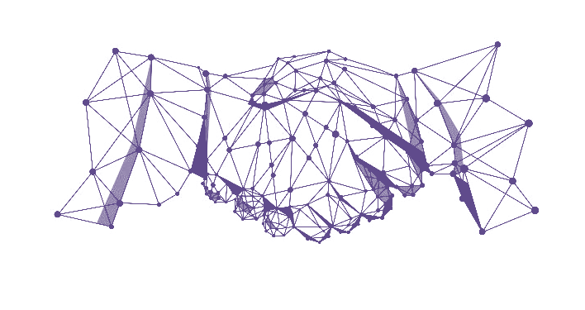
Guardomic – EOSC integration
cloud based solution within the EOSC infrastructure
usage of EOSC advanced services
presence in EOSC marketplace
Notes:
It is cloud based solution on INDIGO Data Cloud offered as SaaS. For scalability it is designed to use automation and orchestratin services of EOSC infrastructure.
It will be also offered by EOSC marketplace.

Slide 7
Notes:
If you have any questions or would like to get more information about Guardomic please visit us at our demo exhibition stand in the hall.

